Slide 1
跟着Kevin学英语(5)
认识字母表
H S C E N T

Slide 2
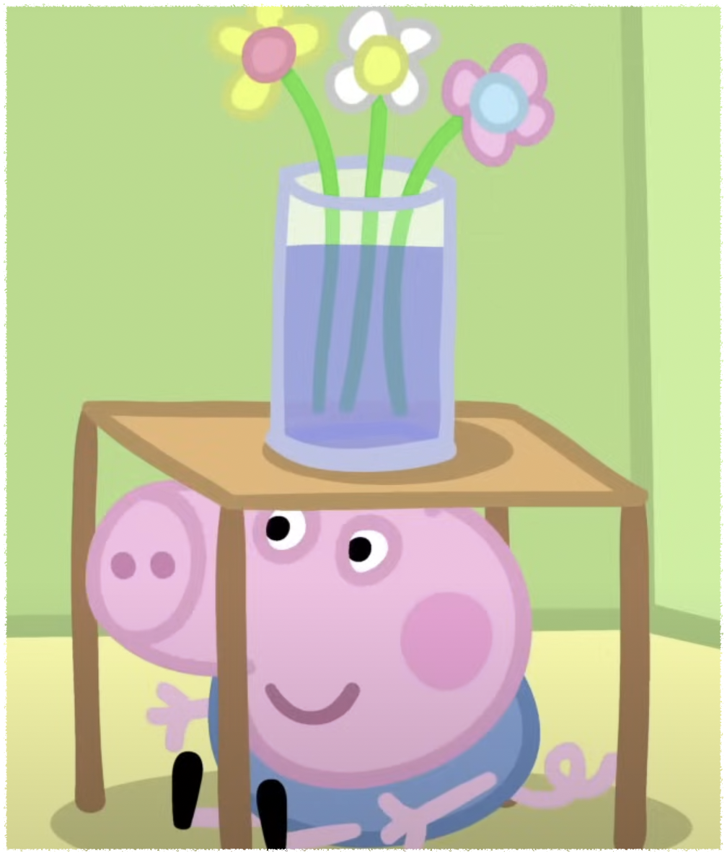
H h
Hide
Notes:
Let’s play hide and seek

Slide 3

S s
Seek
Stairs
Notes:
I want to hide

Slide 4

S s
Seek
Stairs
Notes:
Let’s go upstairs

Slide 5
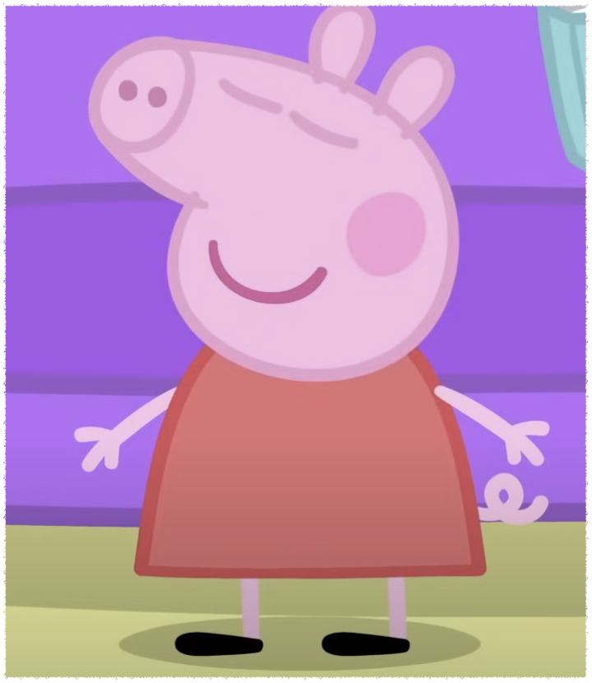
C c
Count
Curtain
Notes:
Ill help you to count

Slide 6

C c
Counting
Curtain
Notes:
She isn’t behind the curtain

Slide 7

E e
Eye
Easy
Notes:
Open your eyes

Slide 8
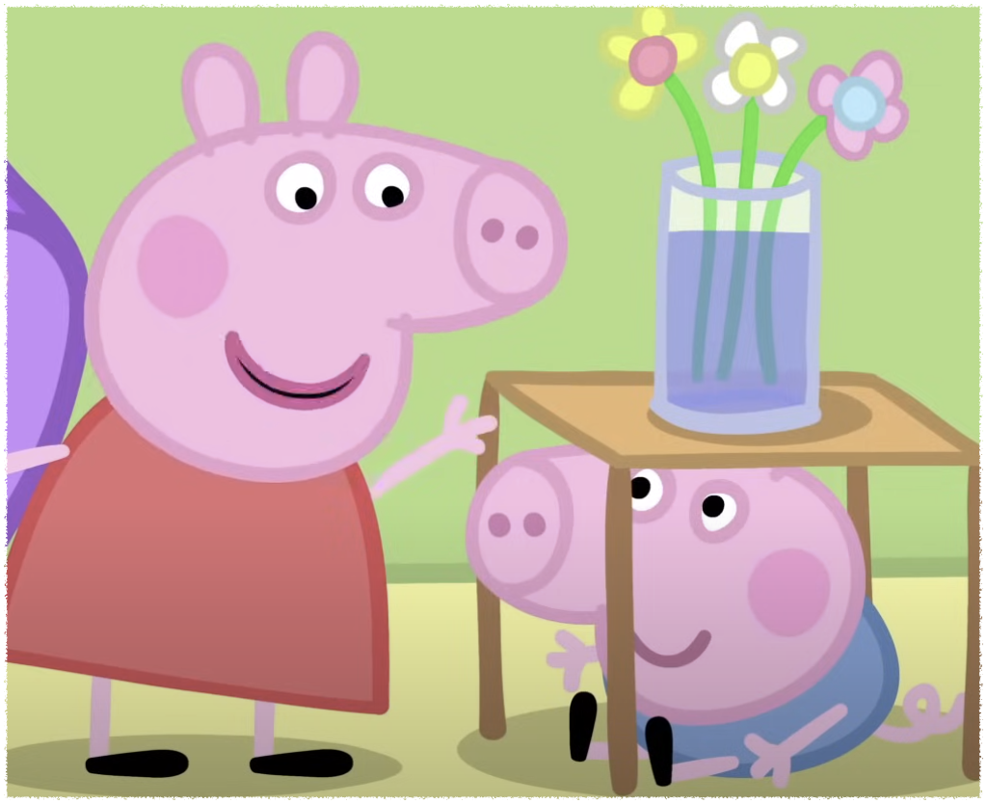
E e
Eye
Easy
Notes:
I can see you too easy

Slide 9

N n
Newspaper
Notes:
Can you read newspaper?

Slide 10

T t
Table
Notes:
This is a table

Slide 11
Ready or not?
Here I come
I can't find you anywhere
Found you

